Slide 1
CSE225: Data Structure and Algorithms Introduction to Data Structure(DS)

Slide 2
RECOMMENDED BOOKS
C++ plus data Structures, Fifth Edition by Nell Dale
Data Structures with C++ Schaum’s Outline Series

Slide 3
Data and Information
Data can be defined as a representation of facts and concepts by values.
Data is collection of raw facts.
Data is represented with the help of characters such as alphabets (A-Z, a-z), digits (0-9) or special characters (+,-,/,*,<,>,= etc.)
Data structure is representation of the logical relationship existing between individual elements of data.

Slide 4
Information
Information is organized or classified data, which has some meaningful values for the receiver. Information is the processed data on which decisions and actions are based.
The processed data must qualify for the following characteristics −
Timely − Information should be available when required.
Accuracy − Information should be accurate.
Completeness − Information should be complete.

Slide 5
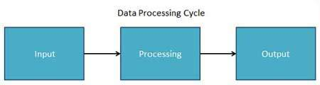
Data Processing Cycle
Input: the input data is prepared in some convenient form for processing
Processing: the input data is changed to produce data in a more useful form
Output: the result of the proceeding processing step is collected.

Slide 6
Algorithm
An Algorithm is a well defined list of steps to solve a problem.
Data structure is the logical or mathematical relationship of individual elements of data.
Algorithm + Data Structure= Program

Slide 7
Why Data Structures?
They are essential ingredients in creating fast and powerful algorithms.
They help to manage the organize data.
They make code cleaner and easier to understand.

Slide 8
Classification of Data Structure
Two broad categories of data structure are :
Primitive Data Structure
Non-Primitive Data Structure

Slide 9
Primitive Data Structure
They are basic structures and directly operated upon by the machine instructions.
Integer, Floating-point number, Character constants, string constants, pointers etc,

Slide 10
Non-Primitive Data Structure
These are derived from the primitive data structures.
Example: Array, Lists, Stack, Queue, Tree, Graph

Slide 11
Difference between them
A primitive data structure is generally a basic structure that is usually built into the language, such as an integer, a float.
A non-primitive data structure is built out of primitive data structures linked together in meaningful ways, such as a linked-list, binary search tree, AVL Tree, graph etc.

Slide 12
Classification of Data Structure
Data structure
Primitive DS
Non-Primitive DS
Integer
Float
Character
Pointer
Integer
Float
Float

Slide 13
Classification of Data Structure
Non-Primitive DS
Linear List
Non-Linear List
Array
Queue
Graph
Trees
Link List
Stack

Slide 14
Types of Data
Characterstic | Description
Linear | In Linear data structures, the data items are arranged in a linear sequence. Example: Array
Non-Linear | In Non-Linear data structures, the data items are not in sequence. Example: Tree, Graph
Homogeneous | In homogeneous data structures, all the elements are of same type. Example: Array
Non-Homogeneous | In Non-Homogeneous data structure, the elements may or may not be of the same type. Example: Structures
Static | Static data structures are those whose sizes and structures associated memory locations are fixed, at compile time. Example: Array
Dynamic | Dynamic structures are those which expand or shrink depending upon the program need and its execution. Also, their associated memory locations changes. Example: Linked List created using pointers

Slide 15
Data Structure Operations
The most commonly used operation on data structure are broadly categorized into following types:
Create
Selection
Updating
Searching
Sorting
Merging
Delete
Insert

Slide 16
Description of various Data Structures : Arrays
An array is defined as a set of finite number of homogeneous elements or same data items.
It means an array can contain one type of data only, either all integer, all float-point number or all character.

Slide 17
Arrays
The elements of array will always be stored in the consecutive (continues) memory location.
The number of elements that can be stored in an array, that is the size of array or its length is given by the following equation:
(Upperbound-lowerbound)+1

Slide 18
Arrays
Insertion of new element
Deletion of required element
Modification of an element
Merging of arrays

Slide 19
Lists
A lists (Linear linked list) can be defined as a collection of variable number of data items.
An element of list must contain at least two fields, one for storing data or information and other for storing address of next element.
For storing address need a special data structure of list that is pointer type.

Slide 20
Lists
Technically each such element is referred to as a node, therefore a list can be defined as a collection of nodes as show bellow:
[Linear Liked List]
Head
AAA
BBB
CCC
Information field
Pointer field

Slide 21
Lists
Types of linked lists:
Single linked list
Doubly linked list
Single circular linked list
Doubly circular linked list

Slide 22
Stack
A stack is also an ordered collection of elements like arrays, but it has a special feature that deletion and insertion of elements can be done only from one end called the top of the stack (TOP)
Due to this property it is also called as last in first out type of data structure (LIFO).

Slide 23
Stack
Insertion of element into stack is called PUSH and deletion of element from stack is called POP.
The bellow show figure how the operations take place on a stack:
PUSH
POP
[STACK]

Slide 24
Stack
The stack can be implemented into two ways:
Using arrays (Static implementation)
Using pointer (Dynamic implementation)

Slide 25
Queue
Queue are first in first out type of data structure (i.e. FIFO)
In a queue new elements are added to the queue from one end called REAR end and the element are always removed from other end called the FRONT end.
The people standing in a railway reservation row are an example of queue.

Slide 26
Queue
The bellow show figure how the operations take place on a queue:
10 | 20 | 30 | 40 | 50
front
rear

Slide 27
Queue
The queue can be implemented into two ways:
Using arrays (Static implementation)
Using pointer (Dynamic implementation)

Slide 28
Trees
Tree is non-linear type of data
Tree represent the hierarchical relationship between various elements.

Slide 29
Trees
There is a special data item at the top of hierarchy called the Root of the tree.
The remaining data items are partitioned into number of mutually exclusive subset, each of which is itself, a tree which is called the sub tree.

Slide 30
Trees
The tree structure organizes the data into branches, which related the information.
A
root
B
C
D
E
F
G

Slide 31
Graph
Graph is a mathematical non-linear data structure capable of representing many kind of physical structures.
Definition: A graph G(V,E) is a set of vertices V and a set of edges E.

Slide 32
Graph
An edge connects a pair of vertices and many have weight such as length, cost and another measuring instrument for according the graph.
Vertices on the graph are shown as point or circles and edges are drawn as arcs or line segment.

Slide 33
Graph
Example of graph:
6
v2
v5
v1
v3
10
v1
8
11
15
9
v2
v3
v4
v4
v4
[a] Directed & Weighted Graph
[b] Undirected Graph

Slide 34
Graph
Types of Graphs:
Directed graph
Undirected graph
Simple graph
Weighted graph
Connected graph
Non-connected graph

Slide 35
OPERATIONS
Data appearing in Data Structure are processed by means of certain operation
Particular DS one chooses for a given situation depends largely on the frequency with which specific operations are performed

Slide 36
MAJOR OPERATION
Traversing: Accessing each record exactly once so that certain items in the record may be processed [ Also known as Visiting the record]
Searching: Finding the location of the record with a given key value, or finding the locations of all record which satisfy one or more conditions
Inserting : Adding a new record to the structure
Deleting : Removing a record from the structure
Sorting: Arranging a list in some logical order.
Merging: Combing two list in a single list.

Slide 37
Abstract Data Type
Abstract Data Types (ADT's) are a model used to understand the design of a data structure. Abstract mean an implementation-independent view of the data structure.
ADTs specify the type of data stored and the operations that support the data

Slide 38
Abstract data type (ADT)
Abstract data type (ADT) is a specification of a set of data and the set of operations that can be performed on the data. Each operation does a specific task.

Slide 39
Uses of ADT
1. It helps to efficiently develop well designed program
2. Facilitates the decomposition of the complex task of developing a software system into a number of simpler subtasks
3. Helps to reduce the number of things the programmer has to keep in mind at any time
4. Breaking down a complex task into a number of earlier subtasks also simplifies testing and debugging

Slide 40
List o f ADT’s:
1. Insertion at first, middle, last
2. Deletion at first, middle, last
3. Searching
4. Reversing
5. Traversing
6. Modifying the list,
7. Merging the list

Slide 41
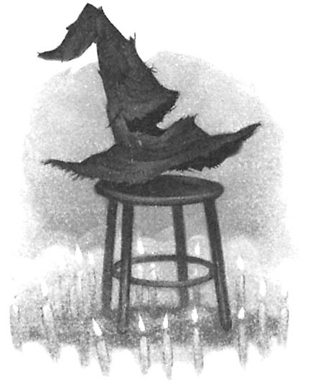
Sorting and Searching
"There's nothing in your head the sorting hat can't see. So try me on and I will tell you where you ought to be."
-The Sorting Hat, Harry Potter and the Sorcerer's Stone

Slide 42
Sorting and Searching
Fundamental problems in computer science and programming
Sorting done to make searching easier
Multiple different algorithms to solve the same problem
How do we know which algorithm is "better"?
Look at searching first
Examples will use arrays of ints to illustrate algorithms

Slide 43

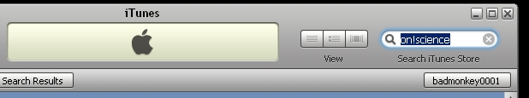
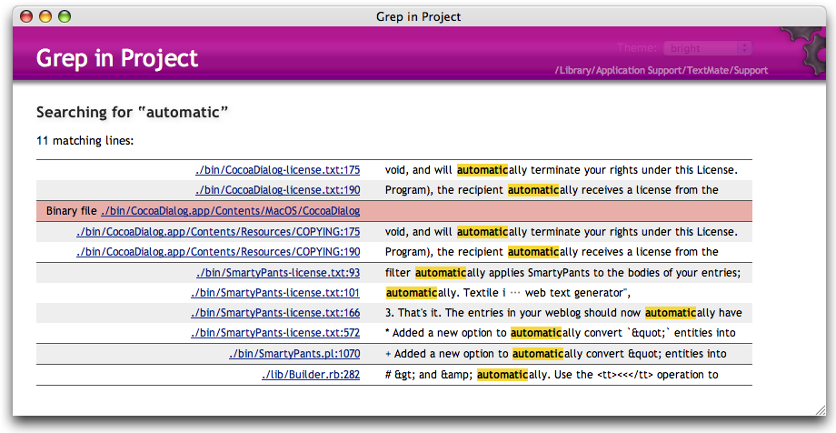
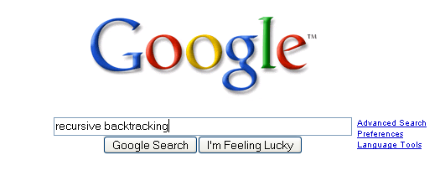
Searching

Slide 44

Searching
Given a list of data find the location of a particular value or report that value is not present
linear search
intuitive approach
start at first item
is it the one I am looking for?
if not go to next item
repeat until found or all items checked
If items not sorted or unsortable this approach is necessary

Slide 45
Attendance Question 1
What is the average case Big O of linear search in an array with N items, if an item is present?
O(N)
O(N²)
O(1)
O(logN)
O(NlogN)

Slide 46
Searching in a Sorted List
If items are sorted then we can divide and conquer
dividing your work in half with each step
generally a good thing
The Binary Search on List in Ascending order
Start at middle of list
is that the item?
If not is it less than or greater than the item?
less than, move to second half of list
greater than, move to first half of list
repeat until found or sub list size = 0

Slide 47
Binary Search
list
low item middle item high item
Is middle item what we are looking for? If not is it
more or less than the target item? (Assume lower)
list
low middle high item item item
and so forth…

Slide 48
Trace When Key == 3 Trace When Key == 30 Variables of Interest?

Slide 49
Attendance Question 2
What is the worst case Big O of binary search in an array with N items, if an item is present?
O(N)
O(N²)
O(1)
O(logN)
O(NlogN)

Slide 50
Generic Binary Search
int bsearch(Comparable list[], Comparable target) { int result = -1; int low = 0;
int high = length - 1;
int mid;
while( result == -1 && low <= high )
{ mid = low + ((high - low) / 2);
if( target=list[mid]) )
result = mid;
else if(target< (list[mid]))
low = mid + 1;
else
high = mid - 1;
}
return result;
}

Slide 51
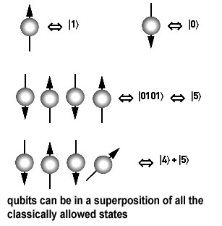
Other Searching Algorithms
Interpolation Search
more like what people really do
Indexed Searching
Binary Search Trees
Hash Table Searching
Grover's Algorithm (Waiting for quantum computers to be built)
best-first
A*

Slide 52

Sorting Fun Why Not Bubble Sort?

Slide 53
Sorting
A fundamental application for computers
Done to make finding data (searching) faster
Many different algorithms for sorting
One of the difficulties with sorting is working with a fixed size storage container (array)
if resize, that is expensive (slow)
The "simple" sorts run in quadratic time O(N²)
bubble sort
selection sort
insertion sort

Slide 54
Stable Sorting
A property of sorts
If a sort guarantees the relative order of equal items stays the same then it is a stable sort
[7₁, 6, 7₂, 5, 1, 2, 7₃, -5]
subscripts added for clarity
[-5, 1, 2, 5, 6, 7₁, 7₂, 7₃]
result of stable sort
Real world example:
sort a table in Wikipedia by one criteria, then another
sort by country, then by major wins

Slide 55
Selection sort
Algorithm
Search through the list and find the smallest element
swap the smallest element with the first element
repeat starting at second element and find the second smallest element
public static void selectionSort(int[] list)
{ int min;
int temp;
for(int i = 0; i < list.length - 1; i++) {
min = i;
for(int j = i + 1; j < list.length; j++)
if( list[j] < list[min] )
min = j;
temp = list[i];
list[i] = list[min];
list[min] = temp;
}
}

Slide 56
Selection Sort in Practice
44 68 191 119 119 37 83 82 191 45 158 130 76 153 39 25
What is the T(N), actual number of statements executed, of the selection sort code, given a list of N elements? What is the Big O?

Slide 57
Generic Selection Sort
public void selectionSort(Comparable[] list) { int min; Comparable temp; for(int i = 0; i < list.length - 1; i++) { { min = i; for(int j = i + 1; j < list.length; j++)
if( list[min].compareTo(list[j]) > 0 ) min = j; temp = list[i]; list[i] = list[min]; list[min] = temp; } }
Best case, worst case, average case Big O?

Slide 58
Attendance Question 3
Is selection sort always stable?
Yes
No

Slide 59
Insertion Sort
Another of the O(N^2) sorts
The first item is sorted
Compare the second item to the first
if smaller swap
Third item, compare to item next to it
need to swap
after swap compare again
And so forth…

Slide 60
Insertion Sort Code
public void insertionSort(int[] list)
{ int temp, j;
for(int i = 1; i < list.length; i++)
{ temp = list[i];
j = i;
while( j > 0 && temp < list[j - 1])
{ // swap elements
list[j] = list[j - 1];
list[j - 1] = temp;
j--;
}
}
}
Best case, worst case, average case Big O?

Slide 61
Attendance Question 4
Is the version of insertion sort shown always stable?
Yes
No

Slide 62
Comparing Algorithms
Which algorithm do you think will be faster given random data, selection sort or insertion sort?
Why?

Slide 63
Sub Quadratic Sorting Algorithms
Sub Quadratic means having a Big O better than O(N²)

Slide 64
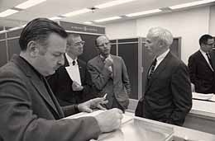
ShellSort
Created by Donald Shell in 1959
Wanted to stop moving data small distances (in the case of insertion sort and bubble sort) and stop making swaps that are not helpful (in the case of selection sort)
Start with sub arrays created by looking at data that is far apart and then reduce the gap size

Slide 65
ShellSort in practice
46 2 83 41 102 5 17 31 64 49 18
Gap of five. Sort sub array with 46, 5, and 18 5 2 83 41 102 18 17 31 64 49 46
Gap still five. Sort sub array with 2 and 17 5 2 83 41 102 18 17 31 64 49 46
Gap still five. Sort sub array with 83 and 31 5 2 31 41 102 18 17 83 64 49 46
Gap still five Sort sub array with 41 and 64 5 2 31 41 102 18 17 83 64 49 46
Gap still five. Sort sub array with 102 and 49 5 2 31 41 49 18 17 83 64 102 46
Continued on next slide:

Slide 66
Completed Shellsort
5 2 31 41 49 18 17 83 64 102 46
Gap now 2: Sort sub array with 5 31 49 17 64 46 5 2 17 41 31 18 46 83 49 102 64
Gap still 2: Sort sub array with 2 41 18 83 102 5 2 17 18 31 41 46 83 49 102 64
Gap of 1 (Insertion sort)
2 5 17 18 31 41 46 49 64 83 102
Array sorted

Slide 67
Shellsort on Another Data Set
0 1 2 3 4 5 6 7 8 9 10 11 12 13 14 15
44 68 191 119 119 37 83 82 191 45 158 130 76 153 39 25
Initial gap = length / 2 = 16 / 2 = 8
initial sub arrays indices:
{0, 8}, {1, 9}, {2, 10}, {3, 11}, {4, 12}, {5, 13}, {6, 14}, {7, 15} next gap = 8 / 2 = 4
{0, 4, 8, 12}, {1, 5, 9, 13}, {2, 6, 10, 14}, {3, 7, 11, 15} next gap = 4 / 2 = 2
{0, 2, 4, 6, 8, 10, 12, 14}, {1, 3, 5, 7, 9, 11, 13, 15}
final gap = 2 / 2 = 1

Slide 68
ShellSort Code
public static void shellsort(Comparable[] list) { Comparable temp; boolean swap;
for(int gap = list.length / 2; gap > 0; gap /= 2) for(int i = gap; i < list.length; i++) { Comparable tmp = list[i];
int j = i;
for( ; j >= gap &&
tmp.compareTo( list[j - gap] ) < 0;
j -= gap )
list[ j ] = list[ j - gap ];
list[ j ] = tmp;
} }

Slide 69
Comparison of Various Sorts
Num Items | Selection | Insertion | Shellsort | Quicksort
1000 | 16 | 5 | 0 | 0
2000 | 59 | 49 | 0 | 6
4000 | 271 | 175 | 6 | 5
8000 | 1056 | 686 | 11 | 0
16000 | 4203 | 2754 | 32 | 11
32000 | 16852 | 11039 | 37 | 45
64000 | expected? | expected? | 100 | 68
128000 | expected? | expected? | 257 | 158
256000 | expected? | expected? | 543 | 335
512000 | expected? | expected? | 1210 | 722
1024000 | expected? | expected? | 2522 | 1550
times in milliseconds

Slide 70

Quicksort
Invented by C.A.R. (Tony) Hoare
A divide and conquer approach that uses recursion
If the list has 0 or 1 elements it is sorted
otherwise, pick any element p in the list. This is called the pivot value
Partition the list minus the pivot into two sub lists according to values less than or greater than the pivot. (equal values go to either)
return the quicksort of the first list followed by the quicksort of the second list

Slide 71
Quicksort in Action
39 23 17 90 33 72 46 79 11 52 64 5 71
Pick middle element as pivot: 46
Partition list
23 17 5 33 39 11 46 79 72 52 64 90 71
quick sort the less than list
Pick middle element as pivot: 33
23 17 5 11 33 39
quicksort the less than list, pivot now 5
{} 5 23 17 11
quicksort the less than list, base case
quicksort the greater than list
Pick middle element as pivot: 17 and so on….

Slide 72
Quicksort on Another Data Set
0 1 2 3 4 5 6 7 8 9 10 11 12 13 14 15
44 68 191 119 119 37 83 82 191 45 158 130 76 153 39 25
Big O of Quicksort?

Slide 73
public static void swapReferences( Object[] a, int index1, int index2 )
{ Object tmp = a[index1];
a[index1] = a[index2];
a[index2] = tmp;
}
public void quicksort( Comparable[] list, int start, int stop )
{ if(start >= stop)
return; //base case list of 0 or 1 elements
int pivotIndex = (start + stop) / 2;
// Place pivot at start position
swapReferences(list, pivotIndex, start);
Comparable pivot = list[start];
// Begin partitioning
int i, j = start;
// from first to j are elements less than or equal to pivot
// from j to i are elements greater than pivot
// elements beyond i have not been checked yet
for(i = start + 1; i <= stop; i++ )
{ //is current element less than or equal to pivot
if(list[i].compareTo(pivot) <= 0)
{ // if so move it to the less than or equal portion
j++;
swapReferences(list, i, j);
}
}
//restore pivot to correct spot
swapReferences(list, start, j);
quicksort( list, start, j - 1 ); // Sort small elements
quicksort( list, j + 1, stop ); // Sort large elements
}

Slide 74
Attendance Question 5
What is the best case and worst case Big O of quicksort? Best Worst
O(NlogN) O(N²)
O(N²) O(N²)
O(N²) O(N!)
O(NlogN) O(NlogN)
O(N) O(NlogN)

Slide 75
Quicksort Caveats
Average case Big O?
Worst case Big O?
Coding the partition step is usually the hardest part

Slide 76
Attendance Question 6
You have 1,000,000 items that you will be searching. How many searches need to be performed before the data is changed to make sorting worthwhile?
10
40
1,000
10,000
500,000

Slide 77
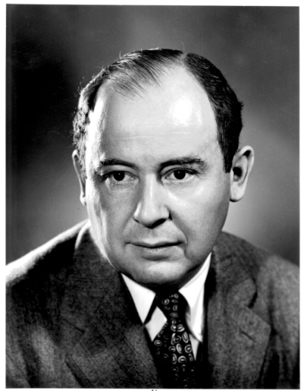

Merge Sort Algorithm
Don Knuth cites John von Neumann as the creator of this algorithm
If a list has 1 element or 0 elements it is sorted
If a list has more than 2 split into into 2 separate lists
Perform this algorithm on each of those smaller lists
Take the 2 sorted lists and merge them together

Slide 78
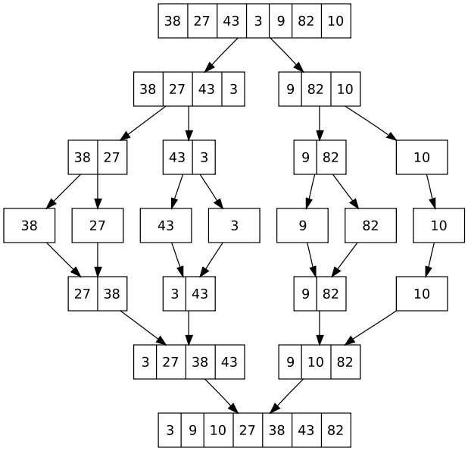
Merge Sort
When implementing
one temporary array
is used instead of
multiple temporary
arrays.
Why?

Slide 79
Final Comments
Language libraries often have sorting algorithms in them
Java Arrays and Collections classes
C++ Standard Template Library
Python sort and sorted functions
Hybrid sorts
when size of unsorted list or portion of array is small use insertion sort, otherwise use O(N log N) sort like Quicksort of Mergesort
Many other sorting algorithms exist.

